Slide 1

Analysis of CO2 emissions and affecting factors
BMIS - 2542
Peng Yuan

Slide 2
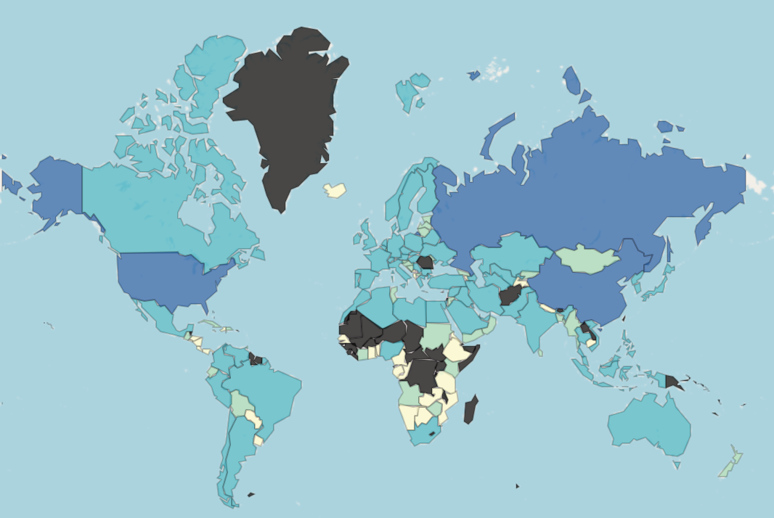
Global CO2 damage data
The blue color from light to dark represents the data from low to high. A visualization of CO2 Damage data for all countries reveals that China, Russian Federation, and the United States have particularly significant emissions

Slide 3
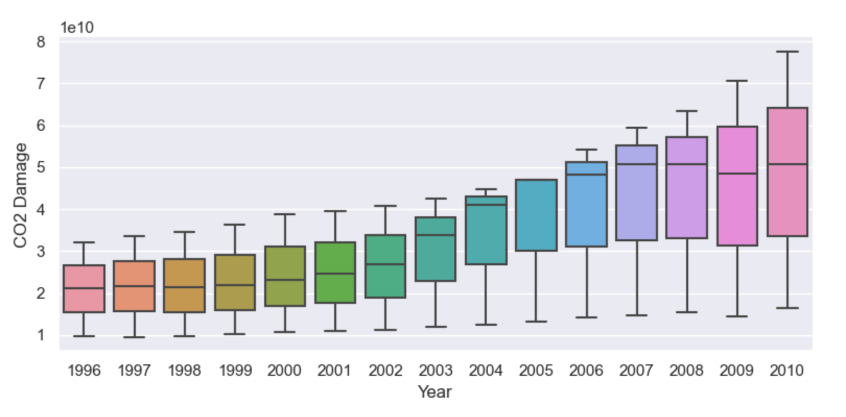
CO2 Damage Overall Trend
There is an overall upward trend in the CO2 Damage data for the three countries. The growth rate of the data has increased since 2000. A certain downward trend is found in the 2009 data.
Notes:
In order to further investigate the reasons for the change in trend, we visualize the trend of CO2 Damage data for each of the three countries.

Slide 4
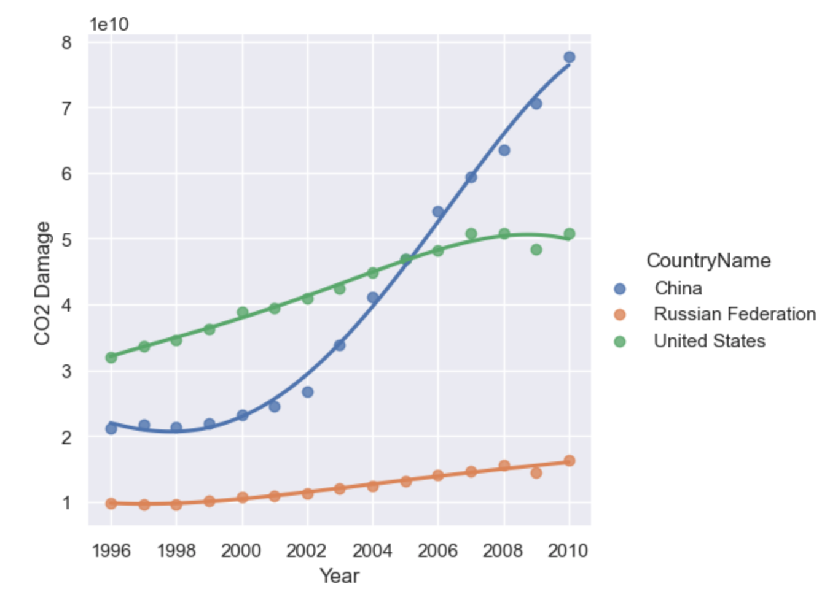
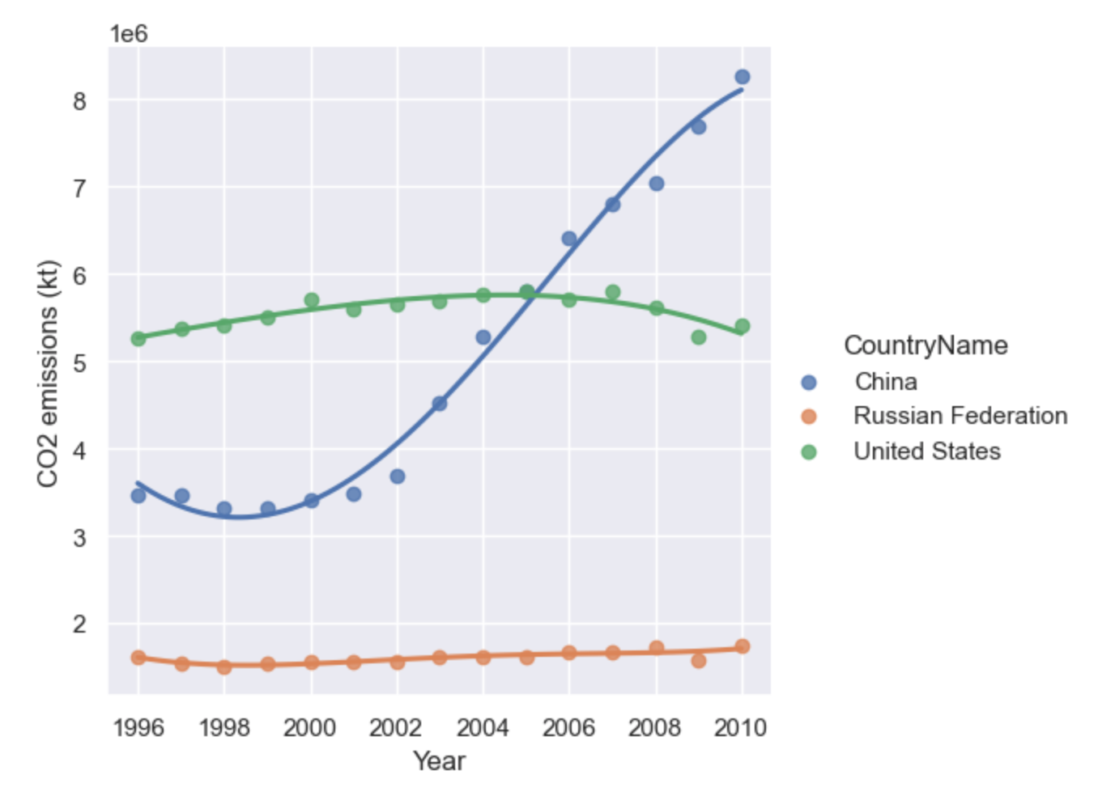
Statistics by country
Notes:
With the two line graphs we find that CO2 emissions and CO2 Damage for the United States and the Russian Federation are rising steadily or almost unchanged, but that China's CO2 emissions have increased dramatically since 2000.The main reason for a certain downward trend in 2009 is that the data for all three countries are lower than the fitted curves in that year. Therefore an overall downward trend is also observed in the quadrant plot. Since the inflection point of China's evolutionary trend is located between 2000 and 2004, we intercepted China's CO2-related data from 1995 to 2005 for further study.

Slide 5
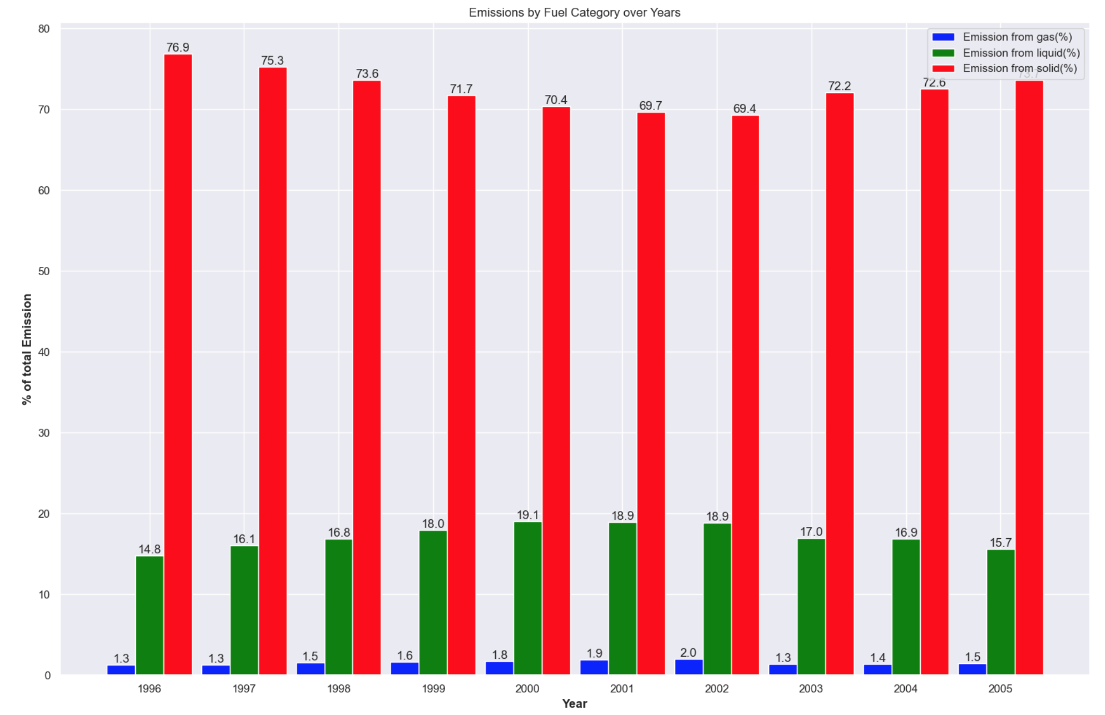
Emission by Fuel Category
The proportion of China's CO2 emissions originating from solid fuels is much higher than that from liquids and gases. The proportion of emissions from solid fuels tends to decrease and then increase. The proportion of emissions from liquid fuels increases and then decreases. The proportion of gaseous emissions remains almost constant.

Slide 6
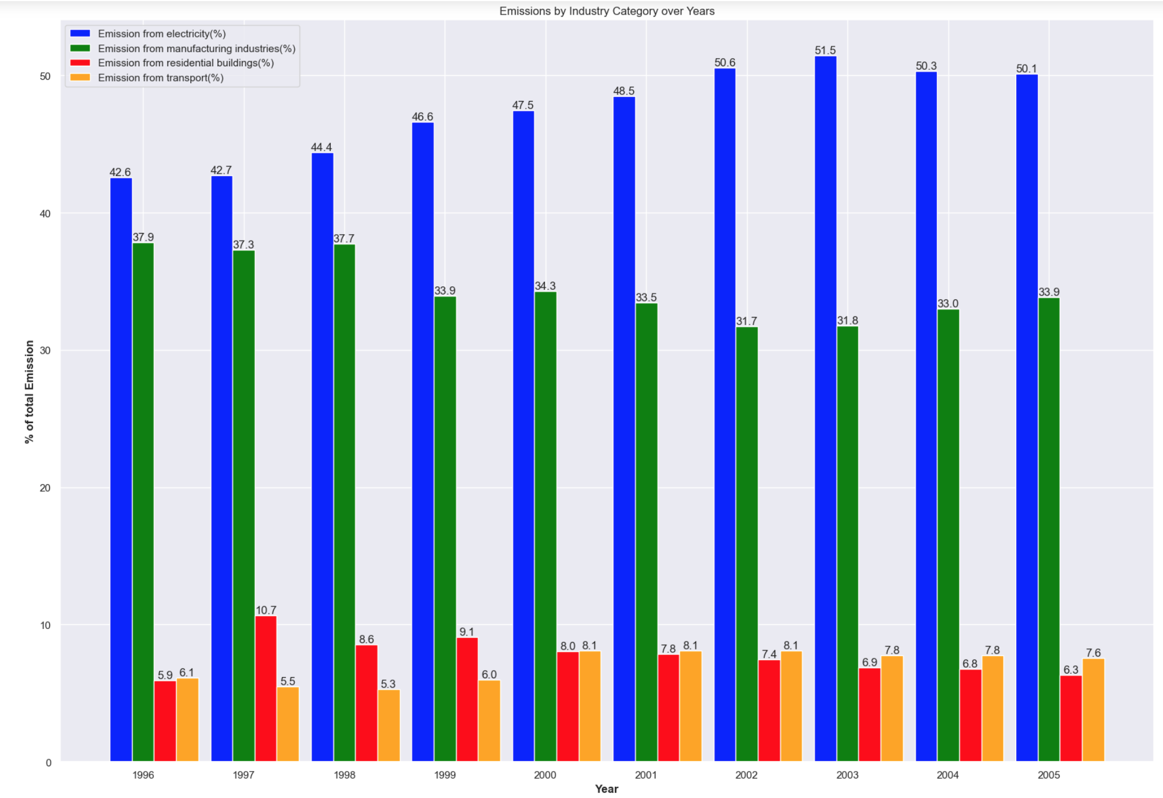
Emission by Industry Category
Notes:
According to the statistics of the proportion of emissions from different industries, it is found that the proportion of CO2 emissions from the electric power industry is the highest, and maintains a rising trend almost year by year. The second highest is from the manufacturing industry. The proportion of CO2 emissions from the construction and transportation industries is very low.

Slide 7
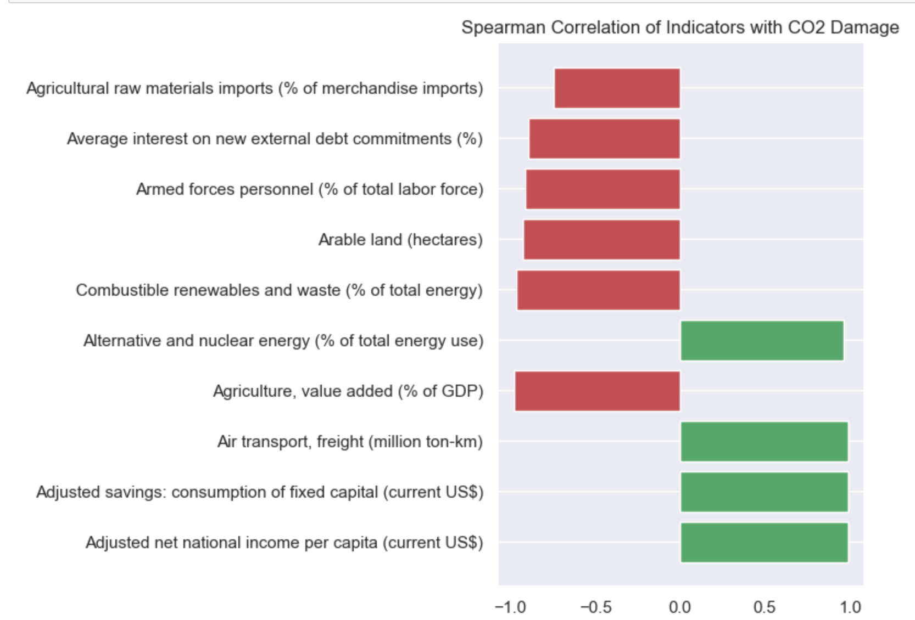
Variable correlation calculation
Notes:
After standardizing the z-score for all variables, the Spearman coefficients were computed after. The 10 variables most likely to be associated with CO2 Damage were obtained after screening. The green color represents positive correlation and the red color represents negative correlation. In the following 10-min project, I will use different models to verify the effect of the 10 variables on CO2 Damage.

Slide 8
Thanks

